Slide 1
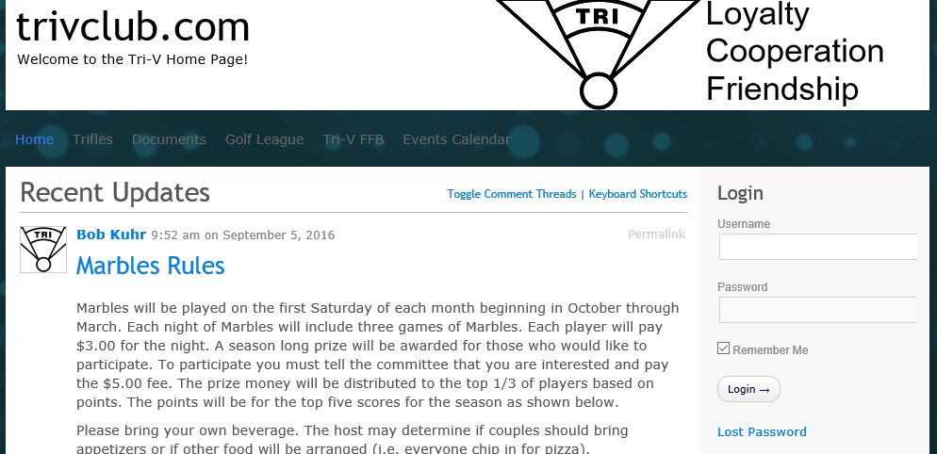
Step 1: Log In
Enter your Username Here
Enter your Password Here
When finished, click Here
If you forgot your password, click Here

Slide 2
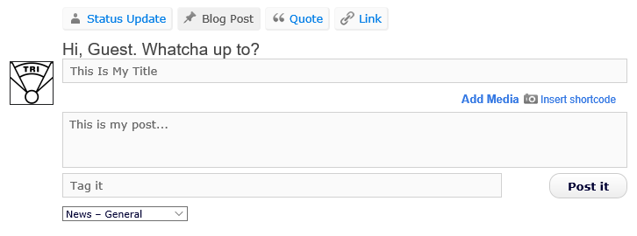
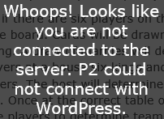
Step 2: Make a Quick Post
Click here first to start a post
Enter the post’s title
Enter the body of the post
OPTIONAL (tags are keywords
to help find your
post later)
Choose a category for your post
When finished, click here
Does this message appear??? Sorry, it means
the “quick post” method is unavailable

