Slide 1
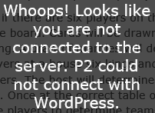
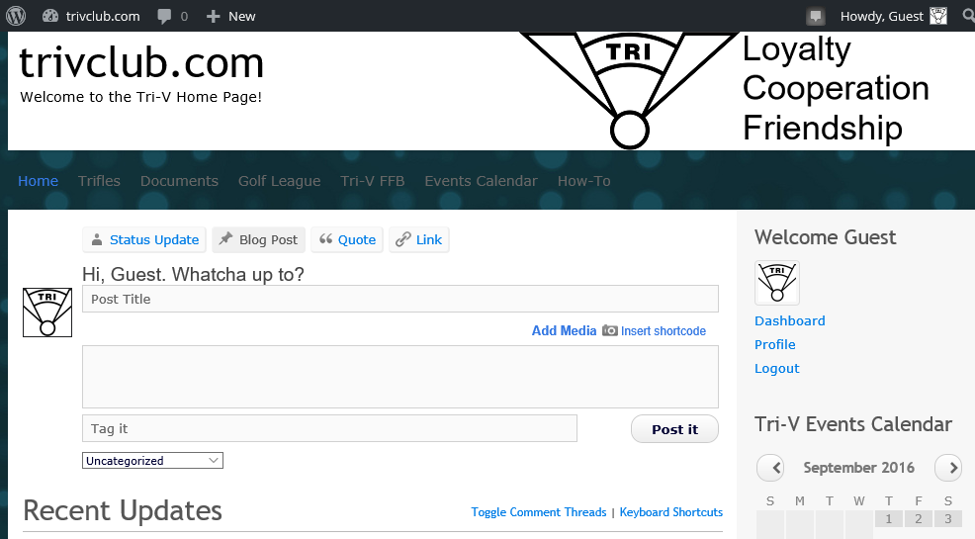
Step 1: Make a Post (alternate method)
Did you get this message? You can still make a posting using this alternate method.
After logging in, click Here

Slide 2
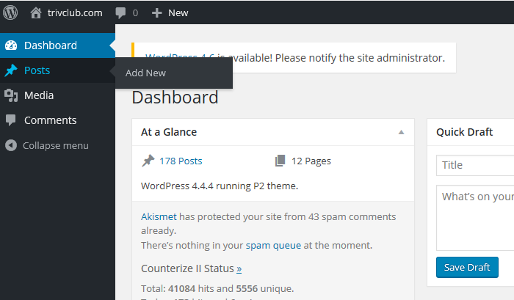
Step 2: Navigate the Dashboard
Click Here

Slide 3
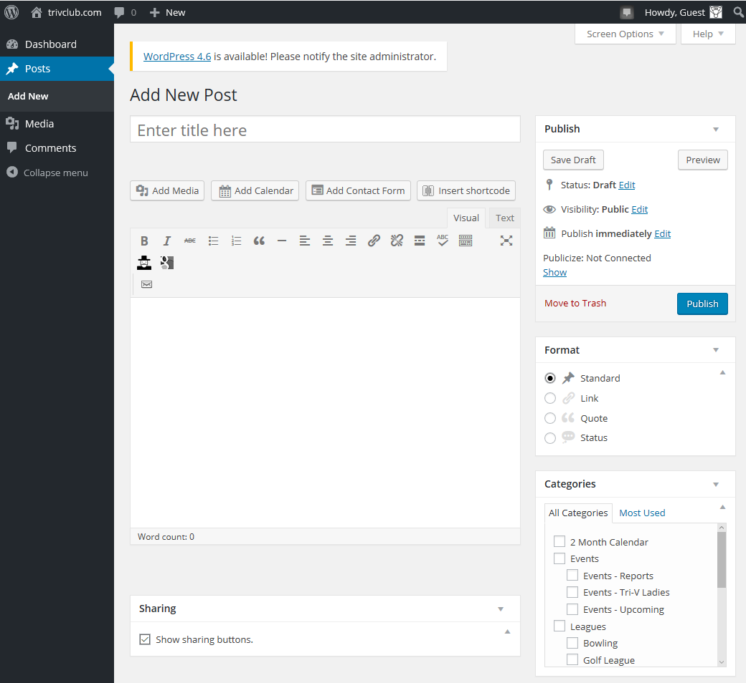
Step 3: Create the Post
Enter the Post’s Title Here
Enter the Post’s Content Here
Select the Post’s
Category Here
When finished,
click here to publish
the post

